Slide 1


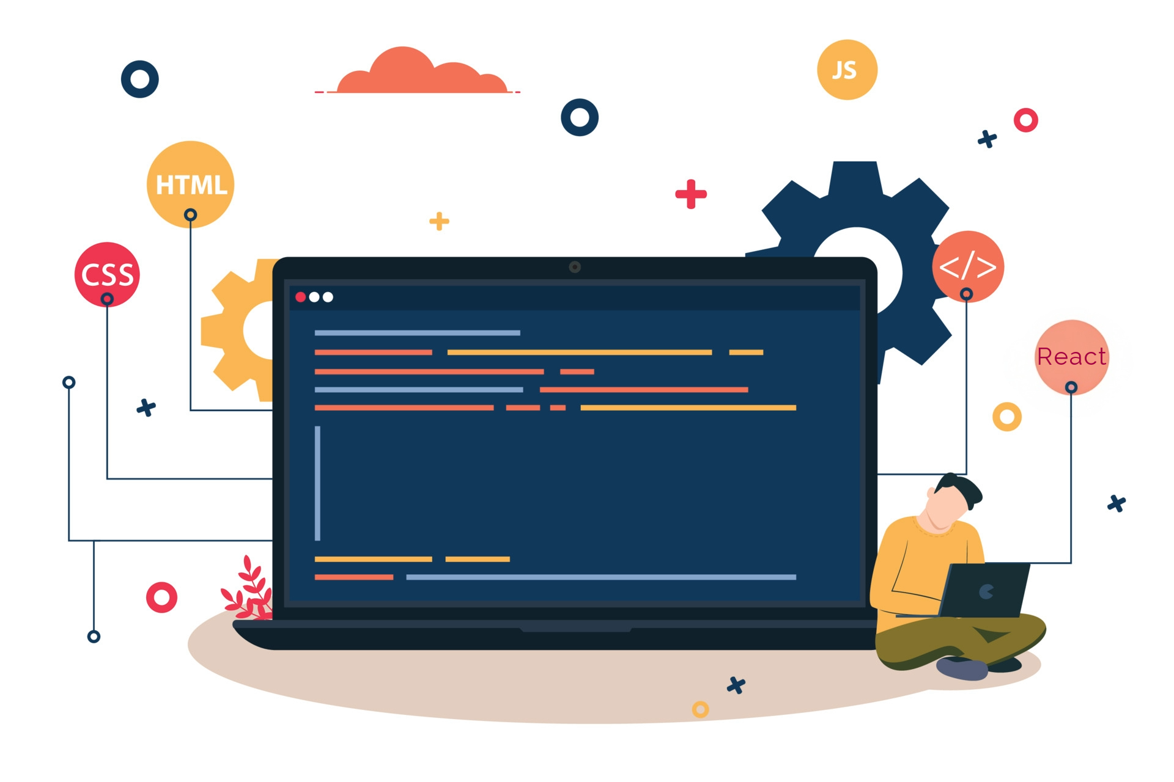



Lecture 23:
States & Props
Course - Web Development - II
-By
Instructor Name
welcome@krmangalam.edu.in
Sohna Road,Gurugram,Haryana 122103

Slide 2

| Table of Contents
States in Class Components.
useState Basics.
Props
References.
The End.

Slide 3
| State in Class Component
In React class components, state is an object used to store dynamic data that can change over time and affect what gets rendered.
Key Points:
State is managed inside the component
When state changes, the component re-renders automatically
It is declared using this.state

Slide 4
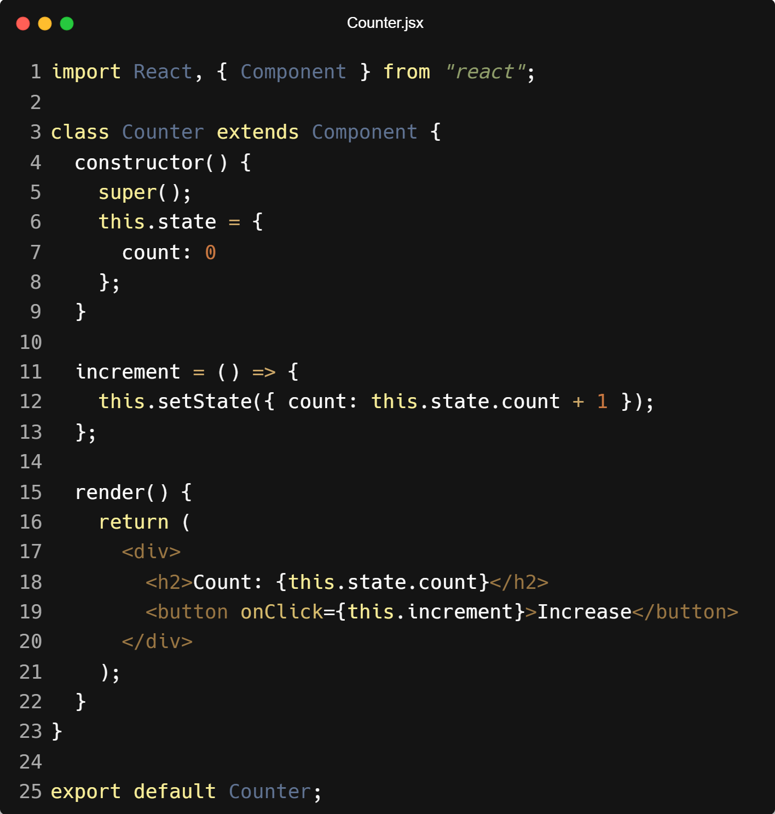
| State in Class Component

Slide 5
| State in Class Component
Important:
Use this.setState() to update state (not direct assignment)
State updates are asynchronous
You can store multiple values in state:

Slide 6

|
Imagine you have a lunchbox that can be empty, half-full, or full. How would you keep track of its current state throughout the day?

Slide 7
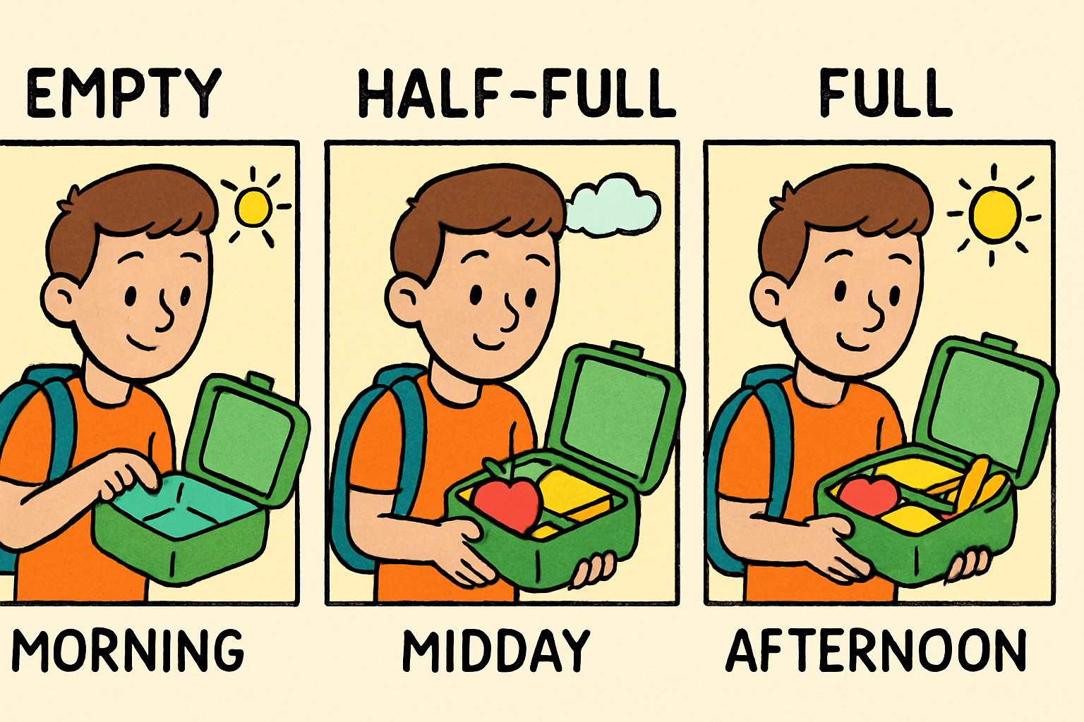
|
Imagine you have a lunchbox that can be empty, half-full, or full. How would you keep track of its current state throughout the day?
To keep track of your lunchbox's state throughout the day, you start by setting an initial state (e.g., empty), update it whenever the lunchbox changes (half-full, full), and use that state to show the current status.
In React, this is like using state to remember and update dynamic data inside a component.

Slide 8
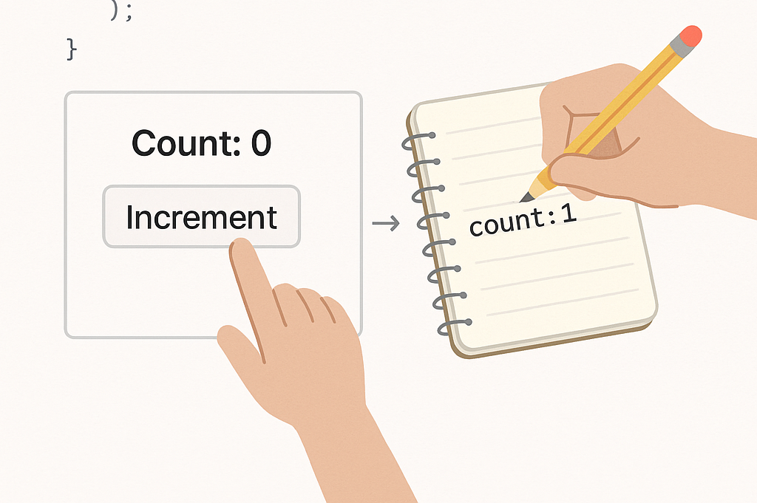
| Introduction to React State
React State is a built-in feature in React that allows components to store and manage dynamic data. It represents values that can change over time due to user interaction, system events, or internal logic.
When state changes, React automatically re-renders the component to reflect the new data in the UI.

Slide 9
| Introduction to React State
Key Points
Each React component can have its own state.
When the state changes, React re-renders the component updating the UI.
State can only be updated using special functions (not directly).
You manage state using the useState() hook in functional components.

Slide 10
| Why do we need React State
To store changing data in a component.
To respond to user actions (like clicks or typing).
To update the UI automatically when data changes.
Makes the app dynamic and interactive.

Slide 11

|
Imagine you have a light switch in your room that you can flip on or off. How do you keep track of whether the light is currently on or off?

Slide 12
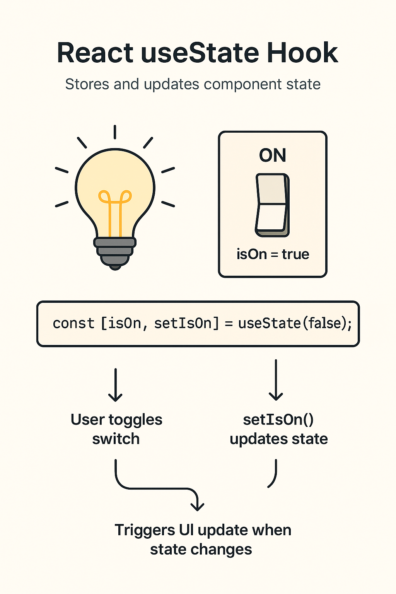
|
Imagine you have a light switch in your room that you can flip on or off. How do you keep track of whether the light is currently on or off?
To keep track of whether a light switch is on or off, you store its current status as a true (on) or false (off) value.
In React, the useState() hook does the same by initializing a state variable (like isOn), updating it when toggled, and re-rendering the UI to show the current light status.

Slide 13
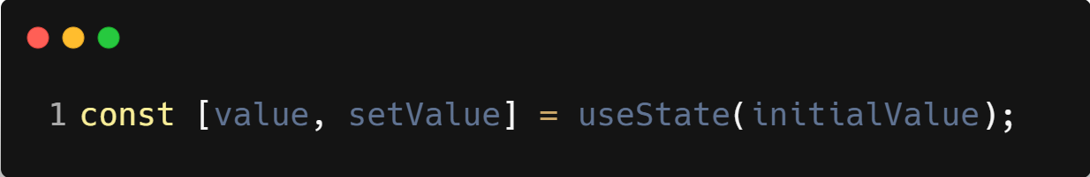
| useState()
useState() is a React Hook that lets you add state (a way to store changing data) to your functional components.
It lets your component remember values — like a counter, a form input, or toggle state.
When the state changes, React automatically re-renders the component to reflect the new value in the UI.
Syntax :

Slide 14
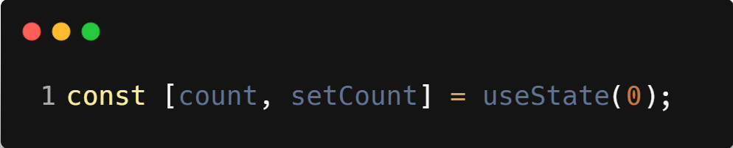
| useState()
Example :
count → the current state value
setCount() → function to update that value
0 → the initial value of count
Key Points:
It comes from React: import { useState } from 'react'
It can be used multiple times to track different values
You must not update state directly — always use the updater function (setCount)

Slide 15
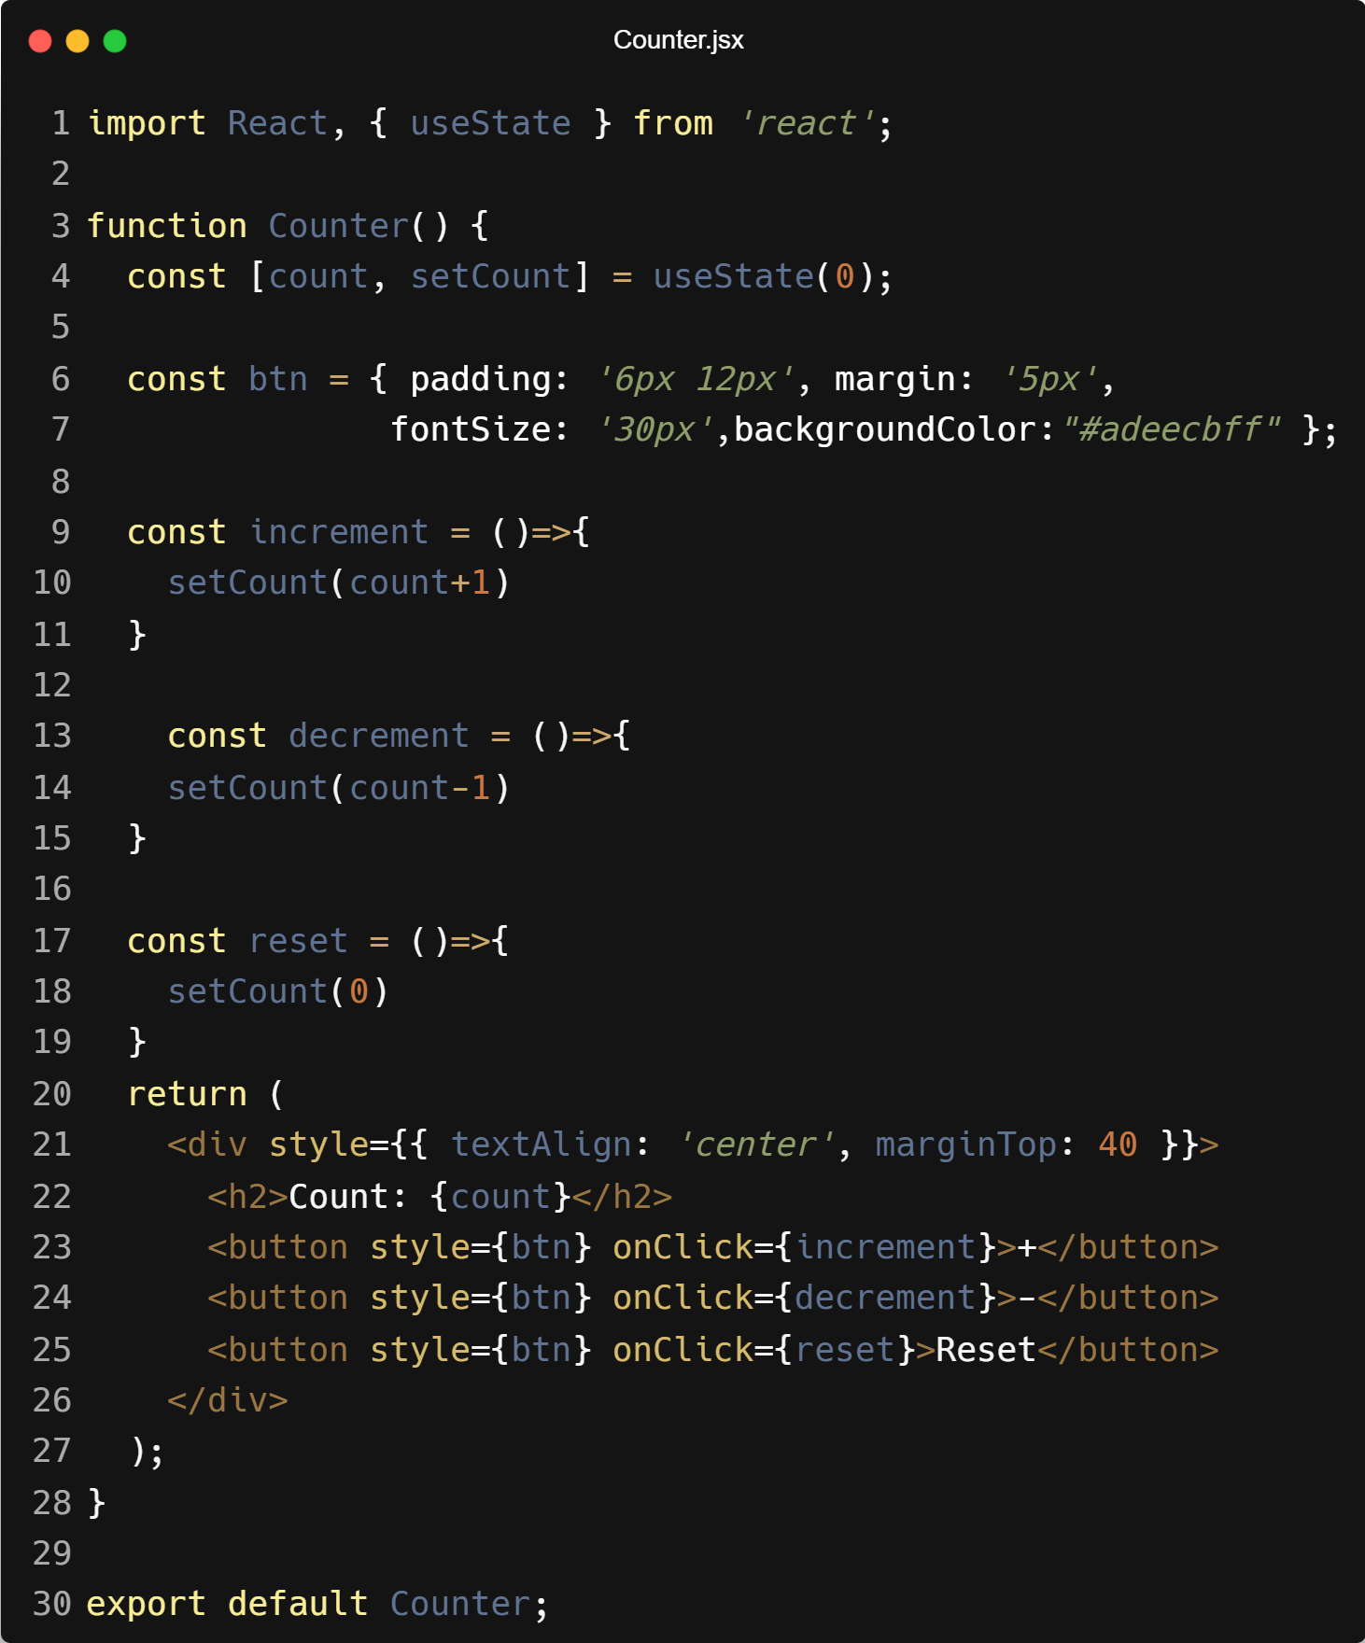
| Example

Slide 16
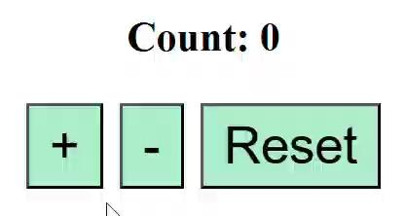
| Output

Slide 17

|
Have you ever seen a family tree or worked on group projects where one person handles a big task and delegates smaller tasks to others?

Slide 18
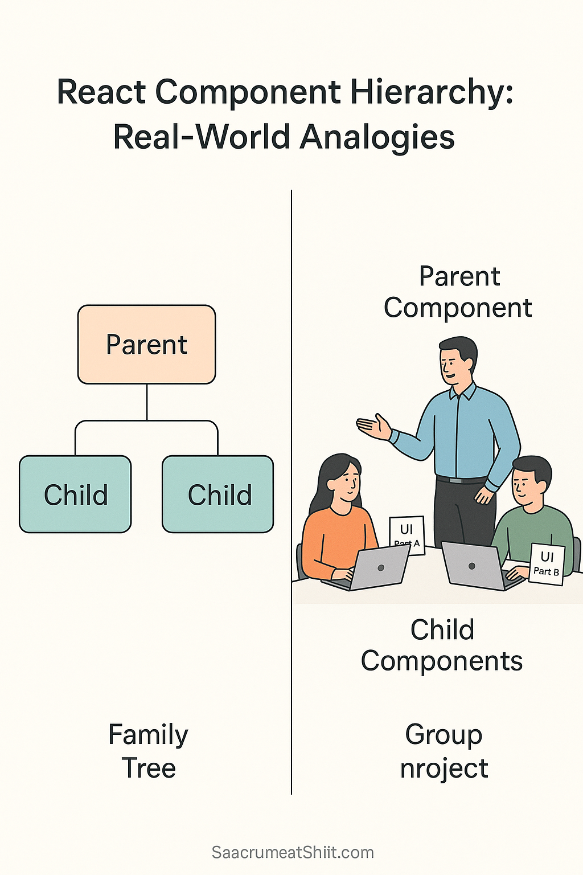
|
Have you ever seen a family tree or worked on group projects where one person handles a big task and delegates smaller tasks to others?
Yes! In a family tree, there are parents and children — just like in React, where we have Parent and Child components."
In group projects, there's usually:
One team leader (Parent) who oversees everything and delegates tasks.
Team members (Children) who each handle a specific part of the project.

Slide 19

|
What if the Parent wants to give the Child some information — like a task description or a tool to use?

Slide 20
|
What if the Parent wants to give the Child some information — like a task description or a tool to use?
Then the Parent needs a way to pass that information down to the Child — and in React, we do that using props."
Just like in real life:
A team leader might hand a task sheet or toolkit to a team member.
In React, the Parent Component sends data (called props) to the Child Component so it can do its specific job.
Think of it like this:
Task description = prop
Tool = prop
Child uses these props to do its job but doesn’t change them — just like a team member follows instructions.

Slide 21
| Props
Props (short for properties) are a way to pass data from a parent component to a child component in React.
Key Points:
Props are read-only — the child cannot change them.
They make components reusable by allowing you to customize them.
Passed like attributes in HTML.

Slide 22
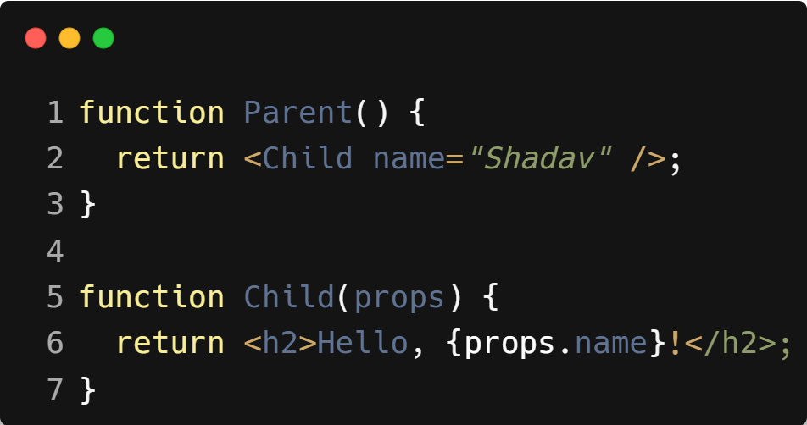
| Example : Props

Slide 23
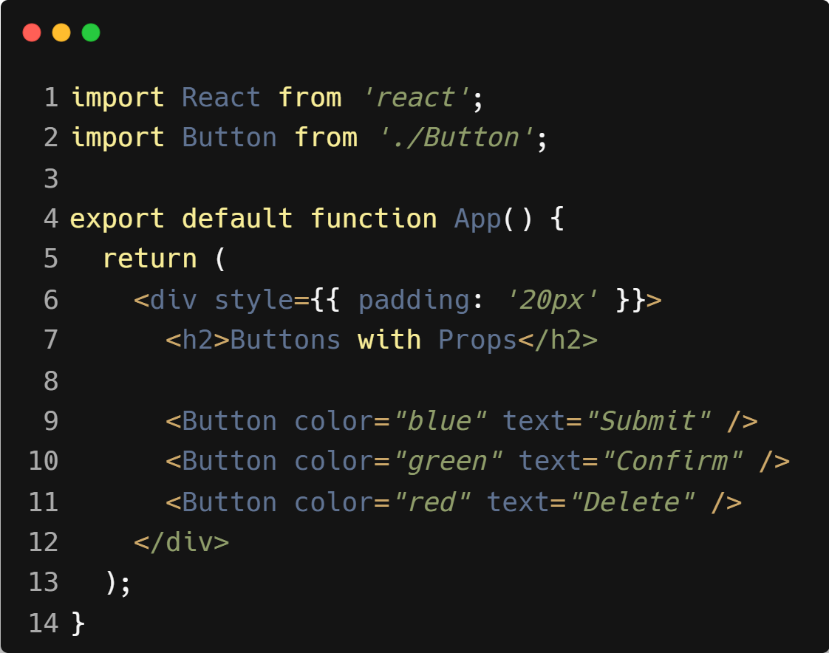
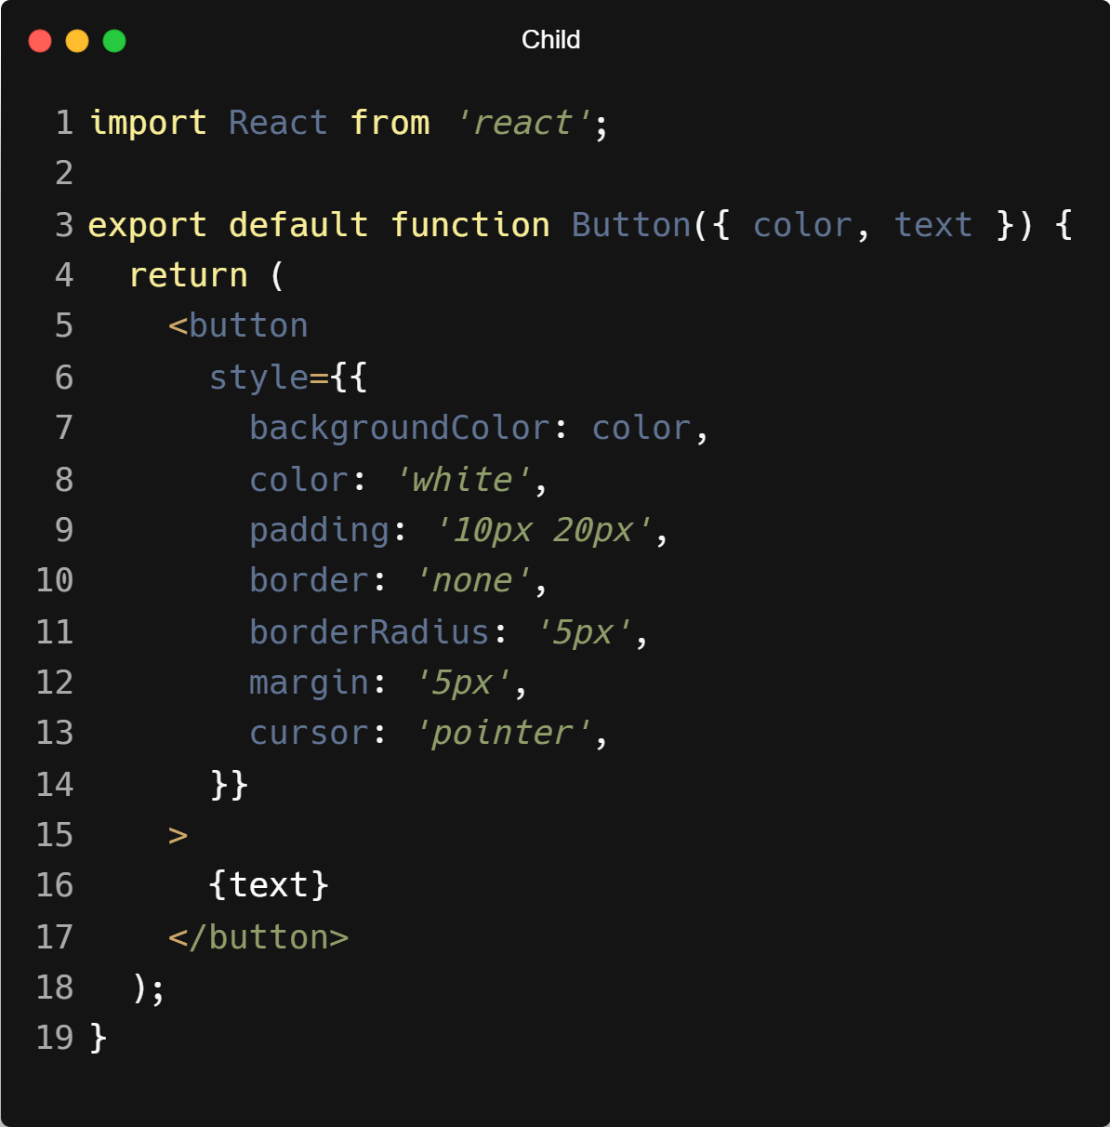
| Program Example : Props
Parent

Slide 24
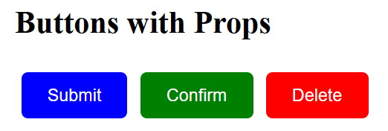
| Output : Props

Slide 25

| Coding Questions
1. Passing a String Prop
Task :
Create a new component named Greeting in a file like src/Greeting.jsx.
This component should accept a name prop.
It should render an <h1> element that says "Hello, [name]!", using the prop.
In App.jsx, import and use the Greeting component, passing your name as the name prop

Slide 26
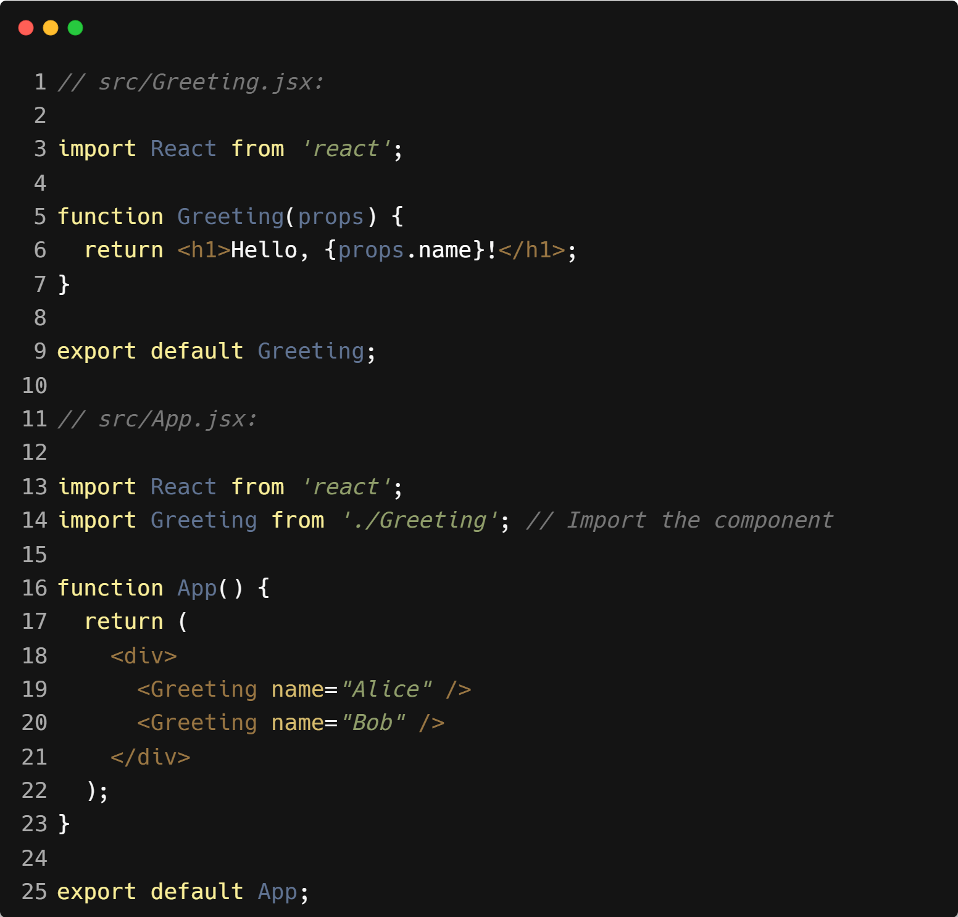
| Coding Questions
Solution :

Slide 27
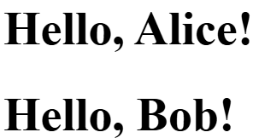
| Coding Questions
Output :

Slide 28
|
Imagine you have a lunchbox that can be empty, half-full, or full. How would you keep track of its current state throughout the day?

Slide 29
|
Imagine you have a lunchbox that can be empty, half-full, or full. How would you keep track of its current state throughout the day?
To keep track of your lunchbox's state throughout the day, you start by setting an initial state (e.g., empty), update it whenever the lunchbox changes (half-full, full), and use that state to show the current status.
In React, this is like using state to remember and update dynamic data inside a component.

Slide 30
| Introduction to React State
React State is a built-in feature in React that allows components to store and manage dynamic data. It represents values that can change over time due to user interaction, system events, or internal logic.
When state changes, React automatically re-renders the component to reflect the new data in the UI.

Slide 31
| Introduction to React State
Key Points
Each React component can have its own state.
When the state changes, React re-renders the component updating the UI.
State can only be updated using special functions (not directly).
You manage state using the useState() hook in functional components.

Slide 32
| Why do we need React State
To store changing data in a component.
To respond to user actions (like clicks or typing).
To update the UI automatically when data changes.
Makes the app dynamic and interactive.

Slide 33
|
Imagine you have a light switch in your room that you can flip on or off. How do you keep track of whether the light is currently on or off?

Slide 34
|
Imagine you have a light switch in your room that you can flip on or off. How do you keep track of whether the light is currently on or off?
To keep track of whether a light switch is on or off, you store its current status as a true (on) or false (off) value.
In React, the useState() hook does the same by initializing a state variable (like isOn), updating it when toggled, and re-rendering the UI to show the current light status.

Slide 35
| useState()
useState() is a React Hook that lets you add state (a way to store changing data) to your functional components.
It lets your component remember values — like a counter, a form input, or toggle state.
When the state changes, React automatically re-renders the component to reflect the new value in the UI.
Syntax :

Slide 36
| useState()
Example :
count → the current state value
setCount() → function to update that value
0 → the initial value of count
Key Points:
It comes from React: import { useState } from 'react'
It can be used multiple times to track different values
You must not update state directly — always use the updater function (setCount)

Slide 37
| Example

Slide 38
| Output

Slide 39
| References
MDN Web Docs : Comprehensive and official documentation for JS. 🔗https://developer.mozilla.org/en-US/docs/Web/JavaScript
W3Schools – JS Tutorial : Beginner-friendly JS tutorials with examples and interactive editors. 🔗 https://www.w3schools.com/js/
react.dev - A comprehensive, tutorial-style website that deeply explores core React concepts, including components, state, effects, and hooks, through interactive examples and in-depth explanations.
🔗https://react.dev/

Slide 40
Thanks
For
Watching
Course - Web Development - II
welcome@krmangalam.edu.in
Sohna Road,Gurugram,Haryana 122103

